Slide 1
Software Product Management Measurements and Analytics
Nandagopal Govindan

Slide 2
Contents
User behaviour analytics
Business analytics
Financial analytics
Performance
Operational costs
Go‐to‐market costs
Sentiment analysis
A/B testing
Case study: Improving business through metrics

Slide 3
Introduction
Product teams use analytics to:
Understand users & then target the right user segments
Understand customer behaviour and improve UX
Measure product adoption & increase value
Measure effectiveness of marketing campaigns

Slide 4
Types of analytics
User behaviour analytics (click paths, engagement)
Business analytics (active users, conversion rate, lifetime value, retention)
Financial analytics (Average selling price, billings)
Performance (load time, uptime)
Operational costs (storage, hosting)
Go‐to‐market costs (acquisition costs, cost of sales, programs)
Sentiment (NPS, customer satisfaction, surveys)
Source: ”Inspired” Chapter 54)

Slide 5
User behaviour analytics
Which features are most popular & which are least
What friction points or issues users are running into
How engaged users are (How often & how long)
The type of users – heavy users, occasional users, freeloaders
What a user workflow looks like

Slide 6
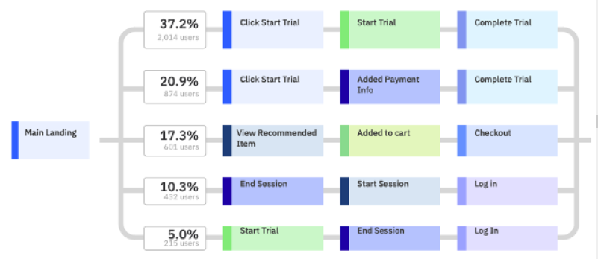
Sample User journey metrics
Source: “Product Analytics for Dummies”

Slide 7
User behaviour analytics
How can we make use of these insights?
Which features are most popular & which are least?
What friction points or issues users are running into?
How engaged users are (How often & how long)?
Who are our heavy users, occasional users, freeloaders?
What a user workflow looks like for a given task?

Slide 8
Experience sharing
How did you improve your product based on user behavior analytics?

Slide 9
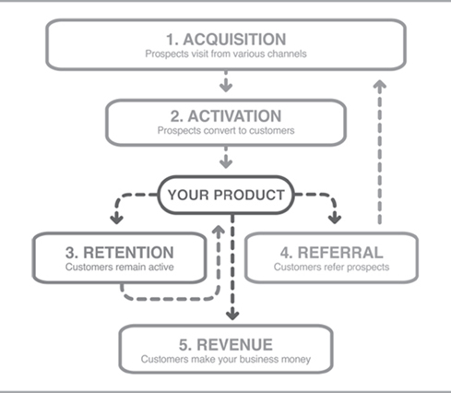
Business analytics
Dave McClure’s AARRR framework
Visits
Conversion

Slide 10
Dave McClure’s AARRR framework
Acquisition: How many prospects (new visitors) are our visiting to our website – due to ads, due to Google search, others?
Activation / Conversion: What percentage of prospects that come to our website sign up as customers?
Retention: What percentage of our customers remain active over time?
Revenue: How much money does each customer generate?
Referral: How many customers refer our product to their friends?

Slide 11
Dave McClure’s AARRR framework
How does this data help us?
Acquisition: How many prospects (new visitors) are our visiting to our website – due to ads, due to Google search, others?
Activation / Conversion: What percentage of prospects that come to our website sign up as customers?
Retention: What percentage of our customers remain active over time?
Revenue: How much money does each customer generate?
Referral: How many customers refer our product to their friends?

Slide 12
Order of optimization
Which metric should we try to improve first & why?
Acquisition
Conversion
Retention
Revenue
Referral
Recommended Order of optimization
Retention
Conversion
Acquisition
Why?
If we are unable to retain, it implies lack of value

Slide 13
Case study: Intuit
(Improving conversion)
Launched a new web product,
Wanted to track and improve the product and business
Customers were coming but had a conversion problem: the percentage of prospects signing up was lower than we had expected it to be.
Source: Book: Lean Product Playbook

Slide 14
Case study: Intuit…
Did analysis & improvements:
Sign-up process that long.
Many prospects were dropping off at different points in the sign-up process.
Conducted usability testing with users - Discovered several UX design issues.
Quickly made UX design improvements.
Result: 40 percent improvement in our conversion rate
Source: Book: Lean Product Playbook

Slide 15
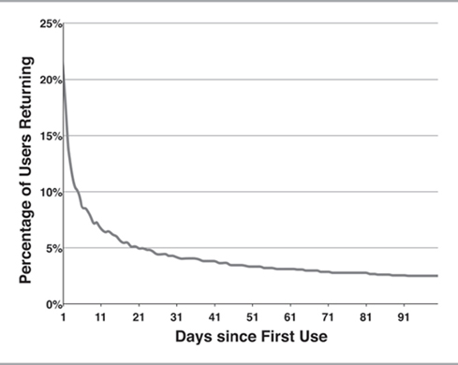
Measuring retention rate
Source: Book: Lean Product Playbook

Slide 16
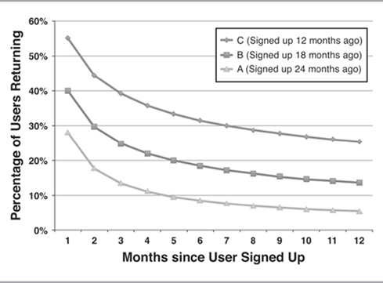
Measuring improvement in retention rate
Cohorts
Retention rate of different cohorts, as the product-market fit is improved
Source: Book: Lean Product Playbook

Slide 17
Revenue related metrics
Average revenue per user: ARPU
Example: Amazon, Ola, RazorPay, Slack, Zoom
Customer Life Time Value = ARPU * Avg. Customer life time (in months or years) * Gross margin
How does this help us in pricing the product?

Slide 18
Sentiment analysis: Net Promoter Score (NPS)
“How likely are you to recommend the product to your friend?”
9 or 10 are called promoters
7 or 8 are called passives
0 through 6 are called detractors
NPS = % of promoters - % of detractors
NPS should increase as you improve product-market fit.
Include in your survey an open-ended question asking customers why they gave the score they did

Slide 19
Experience sharing…
How did you improve your product based on NPS?

Slide 20
A/B testing
Used when the fear of negative impact of the change is high
A/B testing can be used to test
A change in UI
A change in recommendation algorithm
New feature
Any other?

Slide 21
A/B Testing: Example
Let us say you have a landing page.
You see from your analytics that your conversion rate is only 5 percent, much lower than you think it should or could be;
So you design a new, improved version of the landing page.
Now you allow a small % of users to see the new landing page and see if the conversion rate improves or not

Slide 22

Concept of statistical significance
Let us say the conversion rate increased from 5% to 6%
Is this finding reliable?
If our sample size is small, it is not very reliable
If our sample size is large, the finding is more reliable (statistically significant)
There are tools & formulas to help us determine whether the change is significant or not.

Slide 23
A/B Testing in Netflix
Chief Product Officer Neil Hunt says “We use A/B testing for almost everything”
Examples
Test out different user interface variations
Test recommendation algorithms
Test button placements and sizes
He says “We realize that most of the time, we don't know up-front what customers want. The feedback from testing quickly sets us straight, and helps make sure that our efforts are really focused at optimizing the things that make a difference in the customer experience.”

Slide 24
Experience sharing…
For what purpose did you use A/B testing in your product?

Slide 25
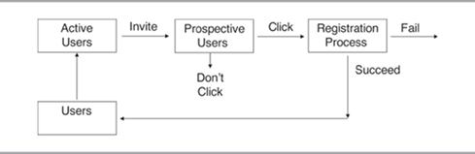
Case study: Friendster’s viral loop
Improving revenue by choosing right metrics to improve
Friendster Viral Loop

Slide 26
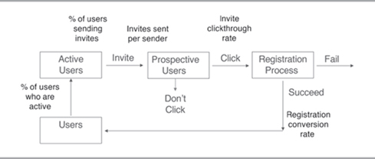
Friendster Viral Loop Metrics

Slide 27
Baseline metrics
Percentage of users sending invites = 15 percent
Average number of invites sent per sender = 2.3
Registration conversion rate = 85 percent
Which metric should we try to improve?

Slide 28
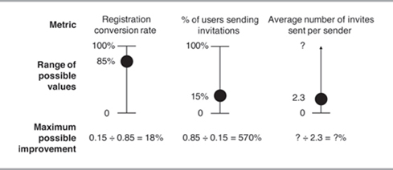
The Upside Potential of a Metric
Has max upside potential

Slide 29
Action to improve
Each user has on an average 100-200 friends. Going from 2.3 to 100 will be a significant improvement.
So we introduced a feature to import address book from Gmail or Yahoo mail and allow user to select the friends they want to send invite to
This changed the avg invites from 2.3 to 5

Slide 30
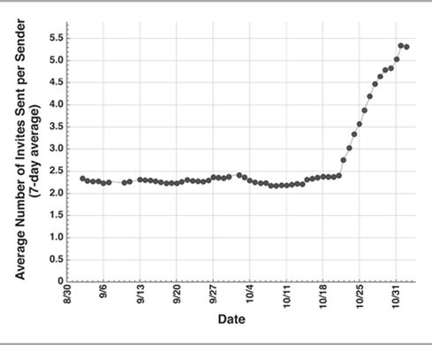
Outcome

Slide 31
Exercise

Slide 32
Appendix

